Slide 1
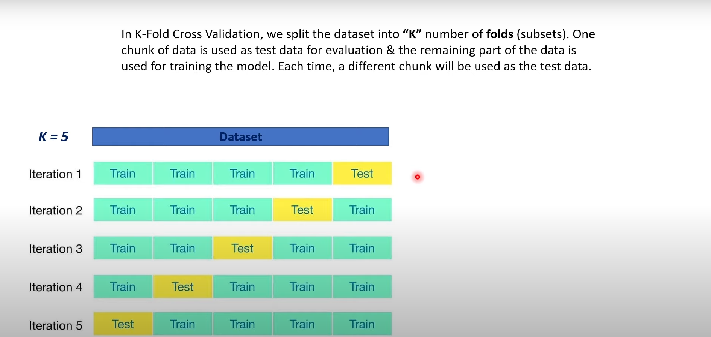

Slide 2
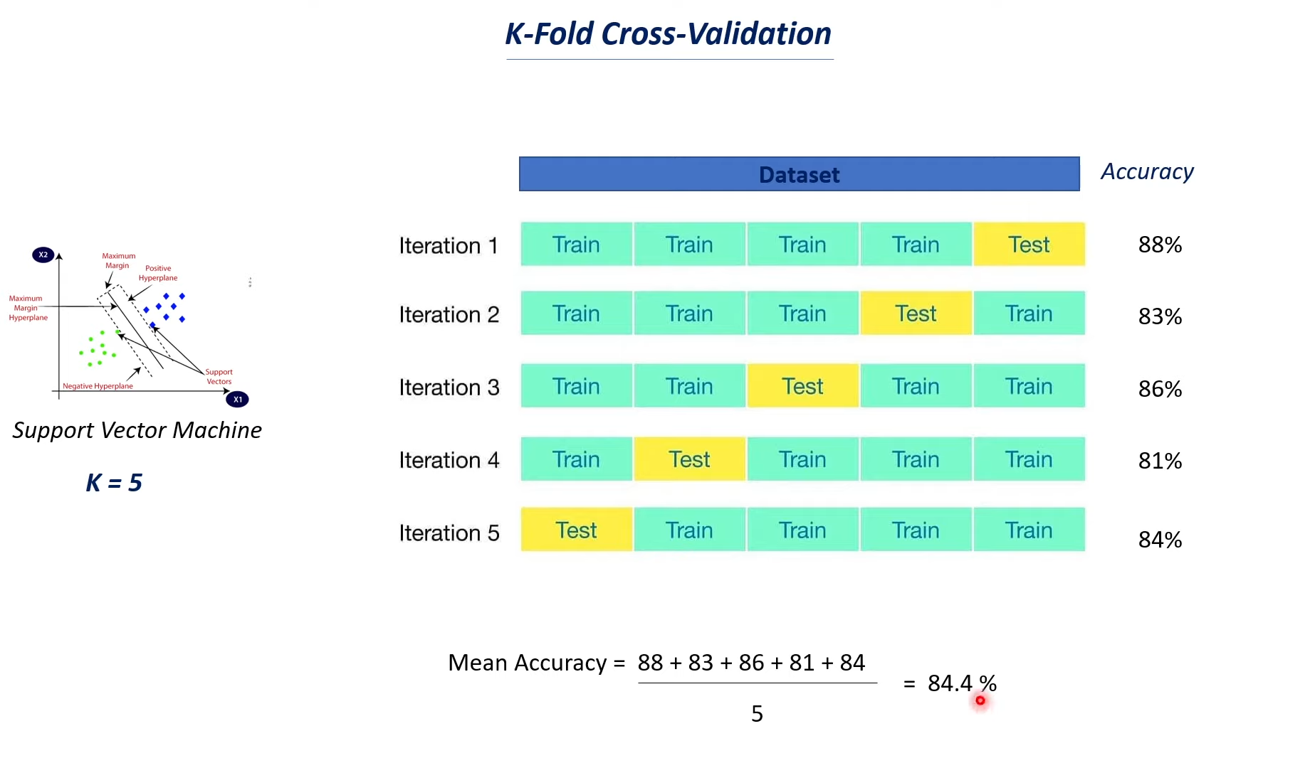
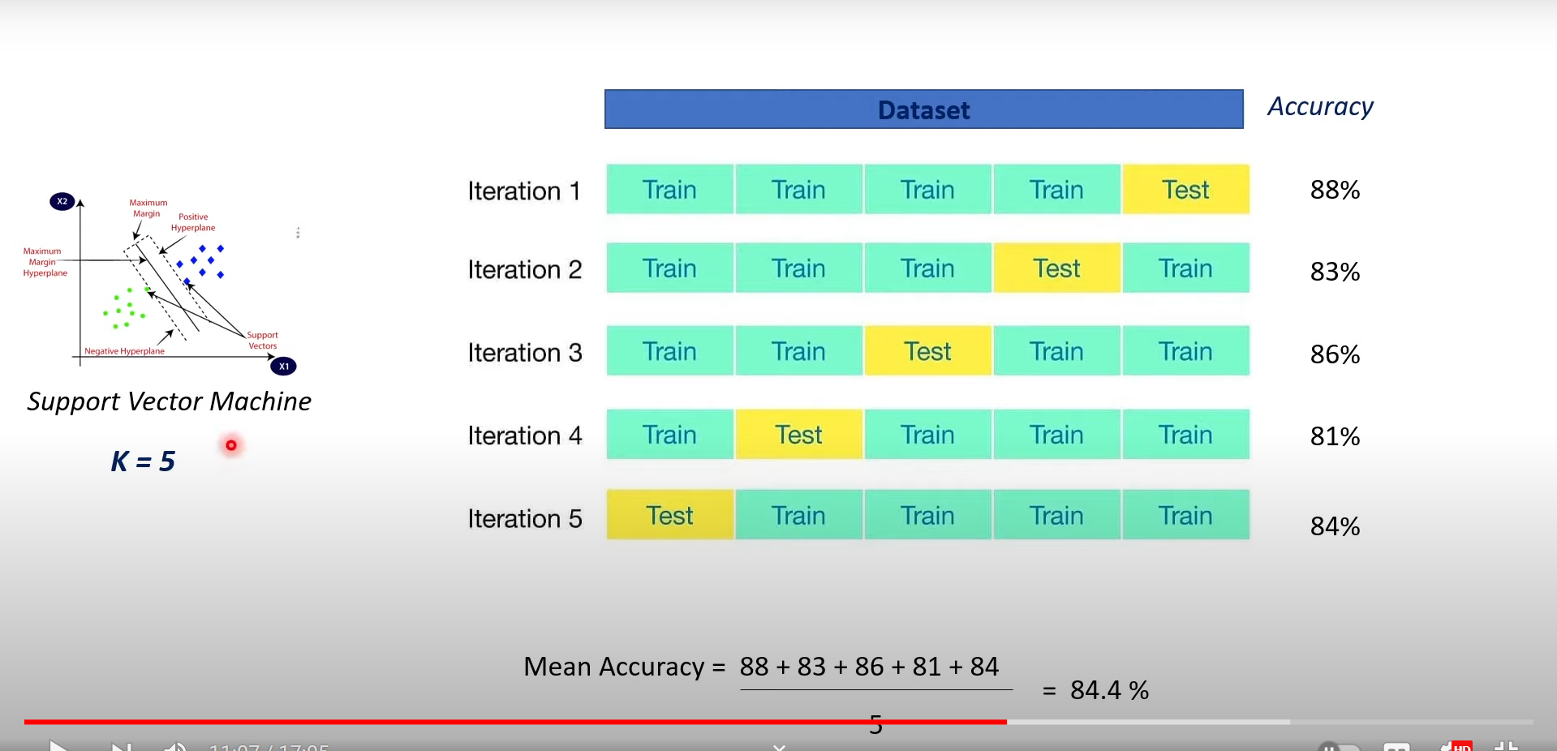
It is used for model selection. Performed cross validation for SVM and logistic regression

Slide 3
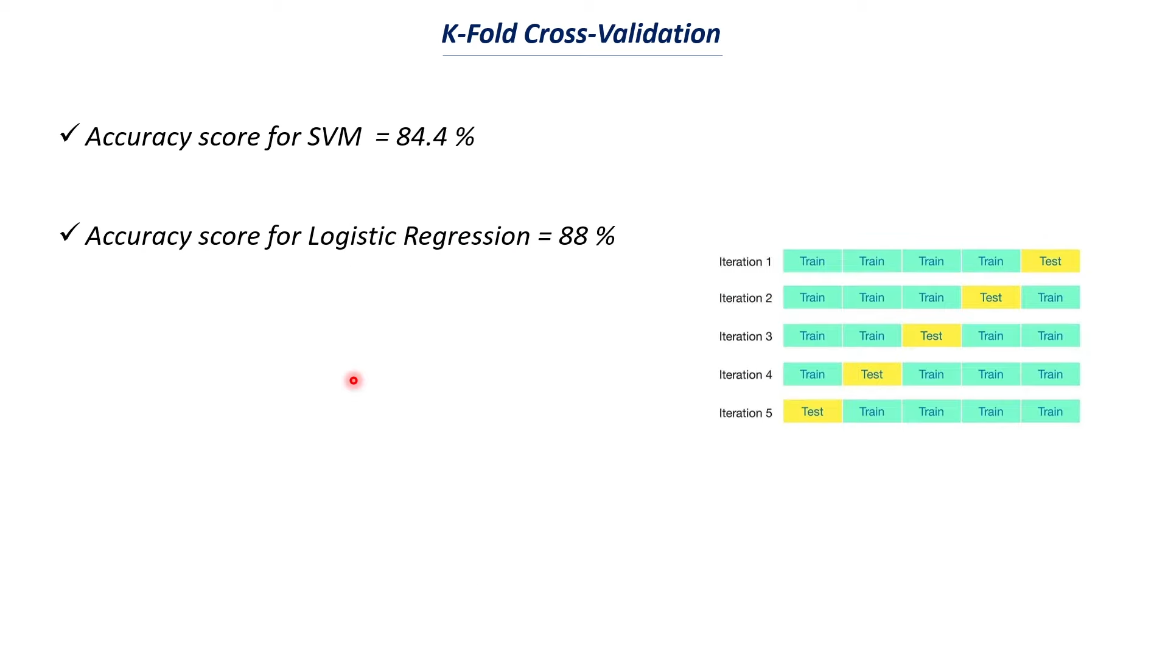
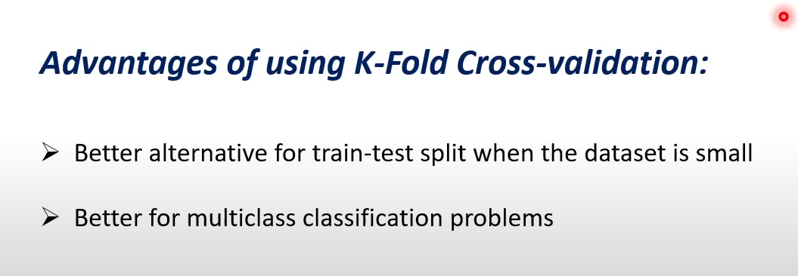
Logistic regression has highest mean accuracy score for this particular dataset
See stratified cross validation, leave one out cross validation

